Slide 1
Lecture on Grammar Problems

Slide 2
Problems with grammar
Ambiguity
Left Recursion
Left Factoring
Removal of Useless Symbols
These can create problems for the parser in the phase of syntax analysis

Slide 3
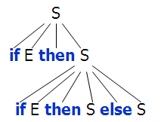
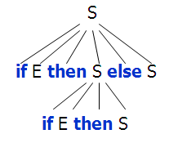
Grammar Problem
Consider S → if E then S else S | if E then S
What is the parse tree for
if E then if E then S else S
There are two possible parse trees! This problem is called ambiguity
A CFG is ambiguous if one or more terminal strings have multiple leftmost derivations from the start symbol.

Slide 4
Ambiguity
There is no general algorithm to tell whether a CFG is ambiguous or not.
There is no standard procedure for eliminating ambiguity.
Some languages are inherently ambiguous.
In those cases, any grammar we come up with will be ambiguous.

Slide 5
How to eliminate Ambiguity? Method 1
If ambiguity is of the form:
S→ α S β S γ | α1 |……| αn
Rewrite:
S→ α S β S’ γ | S’
S’→ α1 |……| αn

Slide 6
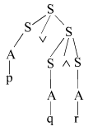
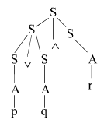
How to eliminate Ambiguity? Method2:
Binding with parenthesis:
S→ S v S | S ^ S | ~ S | A
A→ p| q| r
The two parse trees for the string pvq^r would be :

Slide 7
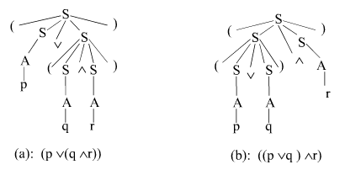
How to eliminate Ambiguity?
Ambiguity can be eliminated by parenthesizing the right hand side of the two rules as shown below:
S→ (S v S) | (S ^ S) | ~ S | A
A→ p| q| r

Slide 8
How to eliminate Ambiguity?
The parenthesizing technique is simple but has serious drawbacks because we are altering the language by adding new terminal symbols
However this technique is very useful in programming languages

Slide 9
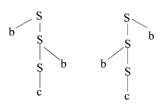
How to eliminate Ambiguity? Method 3
Fixing the order of applying rules:
The language generated by following grammar is ambiguous because bcb can be derived in two different ways:
S→ bS | Sb | c

Slide 10

How to eliminate Ambiguity?
We can simply modify the grammar to such that left side b’s, if any, are always generated first. Figure shown is the only parse tree for string bcb. Grammar is unambiguous.
S→ bS | A
A→ Ab | c

Slide 11
How to eliminate Ambiguity? Method 4
Eliminate redundant rules:
The CFG below is ambiguous because it can generate ab either by B or D.
S→ B | D B→ ab|b D→ ab | d
We can simply delete one of the two and make the grammar unambiguous as follows:
S→ B | D B→ ab|b D→ d

Slide 12
Grammar problems
Because we try to generate a leftmost derivation by scanning the input from left to right, grammars of the form A → A x may cause endless recursion.
Such grammars are called left-recursive and they must be transformed if we want to use a top-down parser.

Slide 13
Left Recursion
A grammar is left recursive if for a non-terminal A, there is a derivation A⇒⁺ Aα
There are three types of left recursion:
direct (A → A x)
indirect (A → B C, B → A )
hidden (A → B A, B → ε)

Slide 14
How to eliminate Left recursion?
To eliminate direct left recursion replace
A → Aα₁ | Aα₂ | ... | Aα_{m} | β₁ | β₂ | ... | β_{n}
with
A → β₁B | β₂B | ... | β_{n}B
B → α₁B | α₂B | ... | α_{m}B | ε

Slide 15
Grammar problems
Consider S → if E then S else S | if E then S
Which of the two productions should we use to expand non-terminal S when the next token is if?
We can solve this problem by factoring out the common part in these rules. This way, we are postponing the decision about which rule to choose until we have more information (namely, whether there is an else or not).
This is called left factoring

Slide 16
Left factoring
A → αβ₁ | αβ₂ |...| αβ_{n} | γ
becomes
A → αB| γ
B → β₁ | β₂ |...| β_{n}

Slide 17
Grammar problems
A symbol X∈V is useless if
there is no derivation from X to any string in the language (non-terminating)
there is no derivation from S that reaches a sentential form containing X (non-reachable)
Reduced grammar = a grammar that does not contain any useless symbols.

Slide 18
Useless symbols
In order to remove useless symbols, apply two algorithms:
First, remove all non-terminating symbols
Then, remove all non-reachable symbols.
The order is important!
For example, consider S ⇒⁺ αXβ where α contains a non-terminating symbol. What will happen if we apply the algorithms in the wrong order?
Concrete example: S → AB | a, A→ a

Slide 19
Useless symbols
Example
Initial grammar:
S→ AB | CA
A→ a
B→ CB | AB
C→ cB | b
D→ aD | d
Algorithm 1 (terminating symbols):
A is in because of A→ a
C is in because of C→ b
D is in because of D→ d
S is in because A, C are in and S→ AC

Slide 20
Useless symbols
Example continued
After algorithm 1:
S→ CA
A→ a
C→ b
D→ aD | d
Algorithm 2 (reachable symbols):
S is in because it is the start symbol
C and A are in because S is in and S→ CA
Final grammar:
S→ CA
A→ a
C→ b

Slide 21
Chomsky Hierarchy: Language Classification
A grammar G is said to be
Regular if it is right linear where each production is of the form A → w B or A → w or left linear where each production is of the form A → B w or A → w
Context free if each production is of the form A → α where A ∈ N and α ∈ (N∪T)*
Context sensitive if each production is of the form α A β → α γ β where A ∈ N, α,γ,β ∈ (N∪T)*, |γ| > 0
Unrestricted

Slide 22
Chomsky Hierarchy
L(regular) ⊂ L(context free) ⊂ L(context sensitive) ⊂ L(unrestricted)
Where L(T) = { L(G) | G is of type T } That is: the set of all languages generated by grammars G of type T
Examples:
Every finite language is regular! (construct a FSA for strings in L(G))
L₁ = { a^{n}b^{n} | n ≥ 1 } is context free
L₂ = { a^{n}b^{n}c^{n} | n ≥ 1 } is context sensitive

